Slide 1
What are
Data Structures?
...
Written by Rachel J. Morris, last updated 1/6/17

Slide 2
Topics:
What is this class?
What are data structures?

Slide 3
Introduction
What are data structures, and why is there a whole class about them?

Slide 4
Introduction
What are data structures, and why is there a whole class about them?
Well… they’re structures… that store data.

Slide 5
Introduction
What are data structures, and why is there a whole class about them?
Well… they’re structures… that store data.
Is that it?

Slide 6
Introduction
What are data structures, and why is there a whole class about them?
Well… they’re structures… that store data.
Is that it?
That’s basically it, but building objects to store data actually gets pretty in-depth.

Slide 7
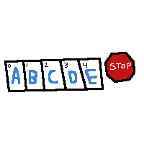
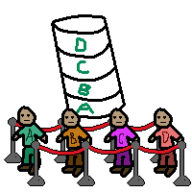
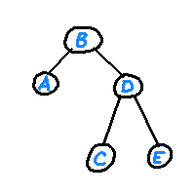
Introduction
Learning about data structures includes learning to build structures that store their data in different manners, such as…
Storing data linearly, without a meaningful order.
Storing data in a queue or a stack type structure, where you can only access the front of the queue or
the top of the stack.
Data stored in a tree structure, which can make searching faster than a list.

Slide 8
List vs. Tree
As an example, let’s store sorted data in a list and in a tree.
List
Tree
0
A
1
B
2
C
3
D
4
F
D
B
F
A
C

Slide 9
List vs. Tree
As an example, let’s store sorted data in a list and in a tree.
List
Tree
0
A
1
B
2
C
3
D
4
F
D
B
F
How would you write an algorithm to find “F” in the list?
If you did it in linear order, you would have to search 4 items before finding “F”!
A
C

Slide 10
List vs. Tree
As an example, let’s store sorted data in a list and in a tree.
List
Tree
0
A
1
B
2
C
3
D
4
F
D
B
F
How would you write an algorithm to find “F” in the list?
If you did it in linear order, you would have to search 4 items before finding “F”!
A
C
For a binary search tree, everything less is to the LEFT, and everything greater is to the RIGHT.

Slide 11
List vs. Tree
As an example, let’s store sorted data in a list and in a tree.
List
Tree
0
A
1
B
2
C
3
D
4
F
D
B
F
How would you write an algorithm to find “F” in the list?
If you did it in linear order, you would have to search 4 items before finding “F”!
A
C
For a binary search tree, everything less is to the LEFT, and everything greater is to the RIGHT.
If we start at “D”, we just go RIGHT to find “F”!

Slide 12
List vs. Tree
As an example, let’s store sorted data in a list and in a tree.
List
Tree
0
A
1
B
2
C
3
D
4
F
D
B
F
How would you write an algorithm to find “F” in the list?
If you did it in linear order, you would have to search 4 items before finding “F”!
Of course, we could write a better searching algorithm… but that’s part of what data structures is about, too!
A
C
For a binary search tree, everything less is to the LEFT, and everything greater is to the RIGHT.
If we start at “D”, we just go RIGHT to find “F”!

Slide 13
Data Structures topics
In order to study this topic, we will be covering many things throughout the semester…
Programming data structures
Building a List object from an array
Building a List object with pointers
Building a Queue from a List
Building a Stack from a List
Building a Tree with pointers
Building a Dictionary
& maybe Heaps and Balanced Search Trees (if there’s time…)

Slide 14
Data Structures topics
In order to study this topic, we will be covering many things throughout the semester…
Programming data structures
Building a List object from an array
Building a List object with pointers
Building a Queue from a List
Building a Stack from a List
Building a Tree with pointers
Building a Dictionary
& maybe Heaps and Balanced Search Trees (if there’s time…)
Learning about algorithms
Measuring algorithm efficiency with O(n)
Searching algorithms
Sorting algorithms

Slide 15
Data Structures topics
In order to study this topic, we will be covering many things throughout the semester…
Programming data structures
Building a List object from an array
Building a List object with pointers
Building a Queue from a List
Building a Stack from a List
Building a Tree with pointers
Building a Dictionary
& maybe Heaps and Balanced Search Trees (if there’s time…)
Learning about algorithms
Measuring algorithm efficiency with O(n)
Searching algorithms
Sorting algorithms
Writing safe, reusable structures
Built-in exceptions in C++
Building our own exception objects
Using try/catch/throw to deal with errors.

Slide 16
So… how do we program a data structure?
We will be using Object Oriented Programming concepts to build abstract, reusable data structures that can be used on any kind of data.
We will review core C++ topics throughout the semester as they come up – such as pointers, operator overloading, and templates, but these are all important to understand as we work on data structures!

Slide 17
So… how do we program a data structure?
In case you forgot over the break…
We can write new objects by creating classes.
Classes contain variables and functions.
We can use pointers to point to memory addresses, which store data.

Slide 18
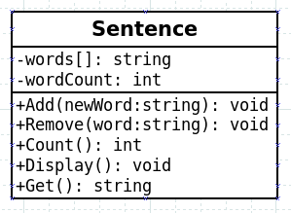

So… how do we program a data structure?
In case you forgot over the break…
We can write new objects by creating classes.
Classes contain variables and functions.
We can use pointers to point to memory addresses, which store data.
This course focuses on writing classes that deal with data, and provide a nice interface for doing so. For example, “Insert”, “Erase”, “Find”, “Count” functionality and so on.

Slide 19
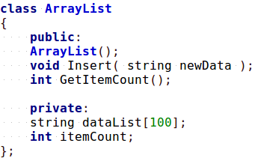
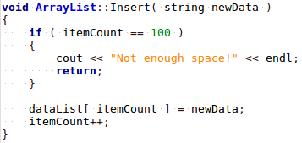
So… how do we program a data structure?
We will provide the user (generally, a programmer using your data structure) with an interface for storing data.
The programmer doesn’t need to know how things are implemented behind-the-scenes to use our structure; they just need to know that they can add and remove data, and find data.
The way that we implement “Insert” will differ based on what kind of structure it is… but the other programmer doesn’t need to know that!

Slide 20
So… how do we program a data structure?
Other programmers only know they can use these public functions.
They don’t know how things are implemented, and they don’t care!

Slide 21
So… how do we program a data structure?
Beyond just storing data, our data structure will also need to handle error checking.
For example: is there some reason we can’t add new data to the list?
How do we handle errors?
Do we handle them inside our structure, or do we pass the error to the other programmer to deal with?
(Either could be an appropriate approach!)

Slide 22
So… how do we program a data structure?
As we go through the semester, we will be concerned with how we are implementing these functions (Insert, Remove, etc.)
And with handling errors so that programs don’t crash from someone misusing our objects
And with providing efficient algorithms for insertions, searching, etc.

Slide 23

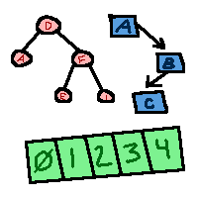
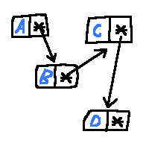
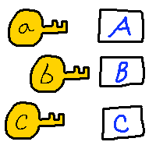
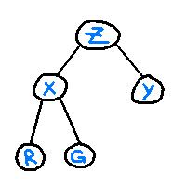
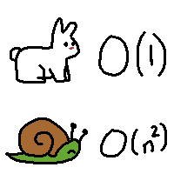
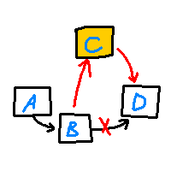
So… how do we program a data structure?
And, that’s the class in a nutshell.

Slide 24
Tips for success…
Sometimes it can be overwhelming working with new topics, especially if the algorithms get complex.
A few tips for doing well are…
If you can’t figure out how to implement some functionality, try to sketch out the problem on paper.
For example, step through inserting one item, then two items, then three items. How does it work?
Getting acquainted with this stuff requires practice, so make sure you have plenty of time to code.
Make sure you have a solid grasp of core C++ topics. If you’re feeling shaky in a certain topic… go back and review!
Ask questions if you’re feeling stuck.
(No judgment… Nobody is born understanding data structures!)

Slide 25
Tips for success…
Sometimes it can be overwhelming working with new topics, especially if the algorithms get complex.
A few tips for doing well are…
Data structures aren’t a secret… there are a lot of resources online that you can reference if the lectures / book aren’t doing it for you!
There are FREE, OPEN books! Free lessons on YouTube!
Source code on GitHub and other locations!
Make sure you understand how each data structure works. You don’t need to have the code memorized, but if you know how it works, you should be able to implement it whenever you need.

